Slide 1







Asynchronous counters & synchronous counters
DIGITAL TECHNIQUES MICRO PROJECT

Slide 2
PARTICIPANTS
NAME | ROLL NO
Hassan Shaikh | 210418
Hassan Shaikh | 210429
Abdurrahman Qureshi | 210451
Chirag Gothankar | 210482

Slide 3
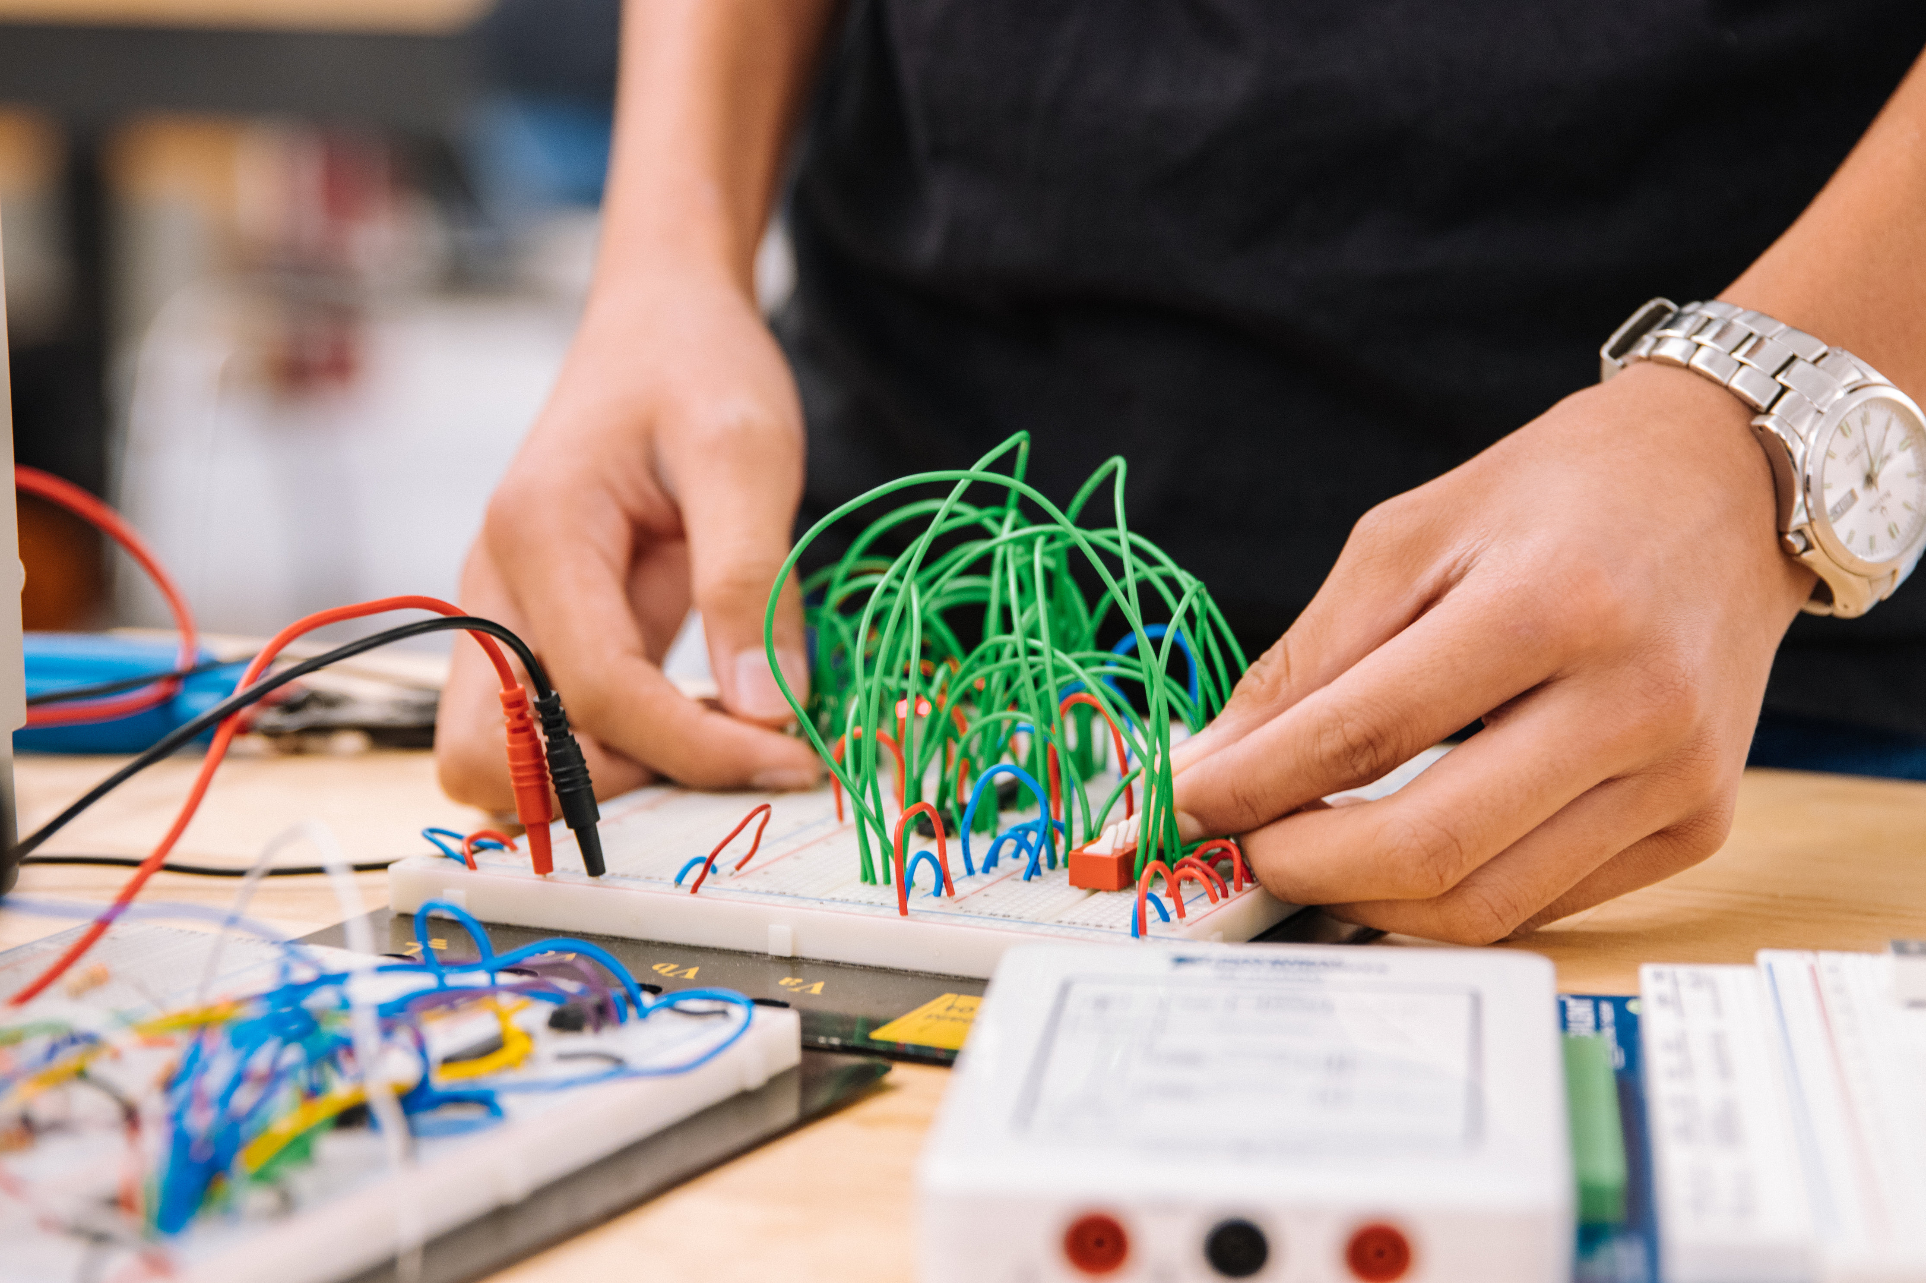
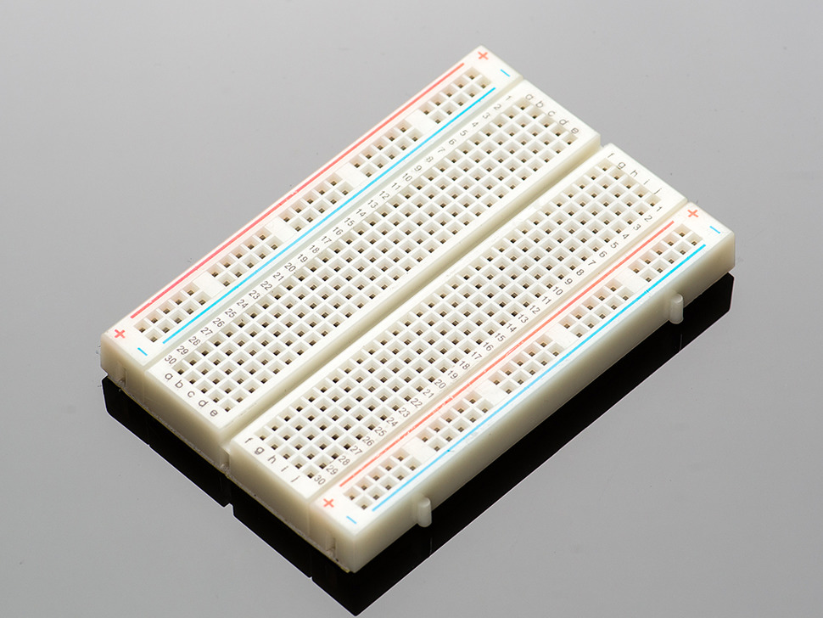
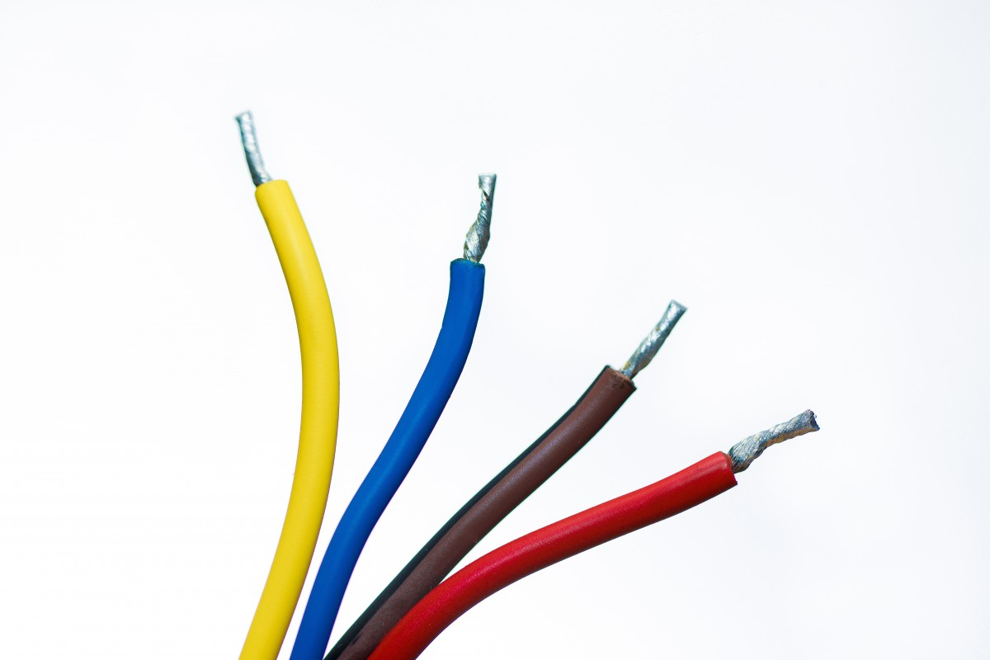
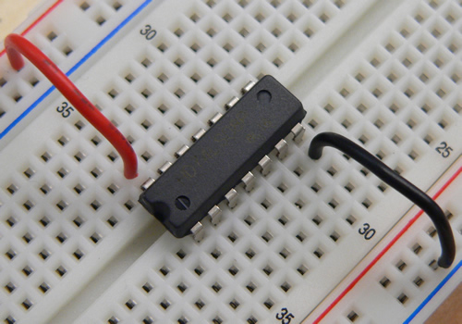



Equipment for Lab
Bread Board
Wires
AND IC
NOT IC
Enter label here
Enter label here

Slide 4
WHAT IS A COUNTER?
A counter is a device which can count any particular event on the basis of how many times the particular event(s) is occurred.
In a digital logic system or computers, this counter can count and store the number of time any particular event or process have occurred, depending on a clock signal.

Slide 5
WHAT IS SYNCHROUNOUS?
Synchronous generally refers to something which is coordinated with others based on time.
Synchronous signals occur at same clock rate and all the clocks follow the same reference clock.

Slide 6
WHAT IS SYNCHROUNOUS COUNTER?
In synchronous counter, the clock input across all the flip-flops use the same source and create the same clock signal at the same time.
So, a counter which is using the same clock signal from the same source at the same time is called Synchronous counter.

Slide 7
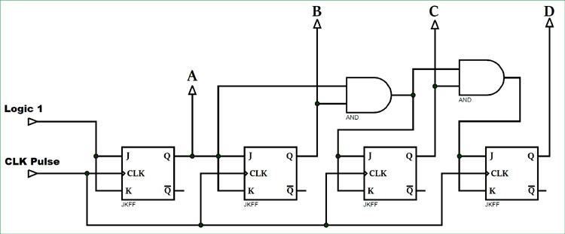
Block Diagram
Synchronous Counter

Slide 8
Uses of Synchronous Counter
Machine Motion control
Motor RPM counter
Rotary Shaft Encoders
Digital clock or pulse generators.
Digital Watch and Alarm systems.

Slide 9
WHAT IS ASYNCHROUNOUS?
Asynchronous stands for the absence of synchronization. Something that is not existing or occurring at the same time.
In computing or telecommunication stream, Asynchronous stands for controlling the operation timing by sending a pulse only when the previous operation is completed rather than sending it in regular intervals.

Slide 10
WHAT IS ASYNCHROUNOUS COUNTER?
An Asynchronous counter can count using Asynchronous clock input. Counters can be easily made using flip-flops.
As the count depends on the clock signal, in case of an Asynchronous counter, changing state bits are provided as the clock signal to the subsequent flip-flops.

Slide 11
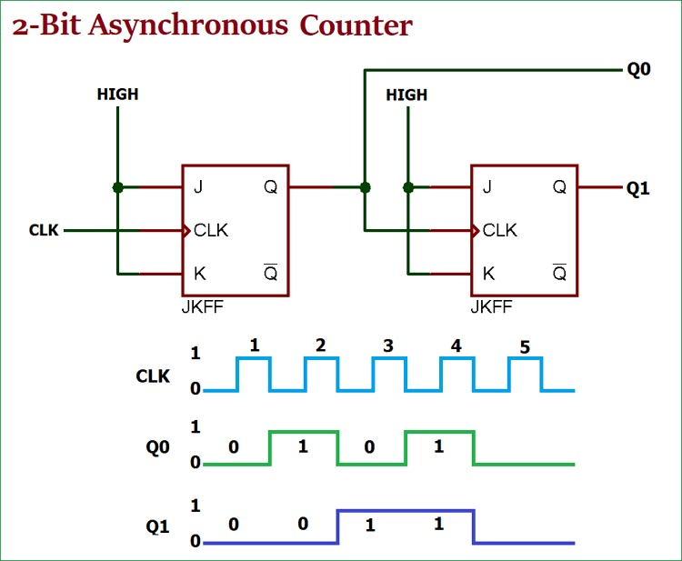
Block Diagram
Asynchronous Counter

Slide 12
Uses of Asynchronous Counter
Asynchronous counters are used as frequency dividers, as divide by N counters.
These are used for low power applications and low noise emission.
These are used in designing asynchronous decade counter.
Also used in Ring counter and Johnson counter.

Slide 13
Electrons are the Citizens of Electricity

